Slide 1
Repurpose.ai Case
Sabrina Manji Caleb Hannon Parth Patel

Slide 2
Companies in the market
Category 1: Utilizes AI to repurpose drugs
Category 2: Utilizes traditional methods to repurpose drugs
Category 3: Utilizes AI to create new drugs
Notes:
Parth

Slide 3
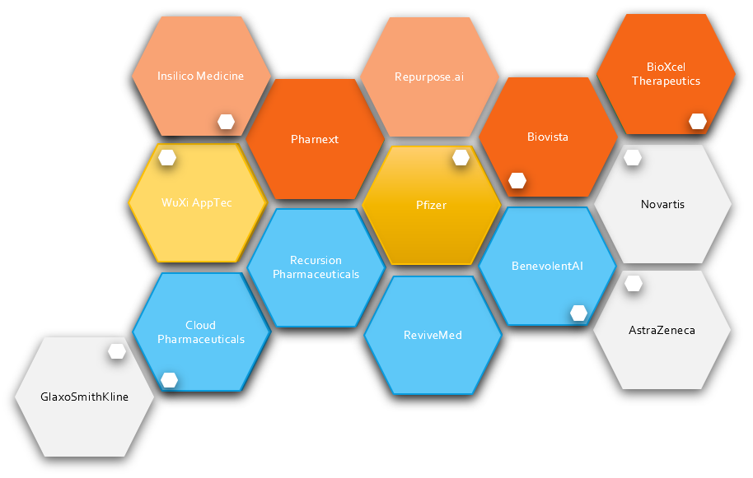
Intramarket Relations
Key:
-Intensity of color indicates age
(paler indicates younger)
-Pairs of smaller hexagons denote partnerships
Category 1
Category 2
Category 3
Partner Companies
Notes:
Parth

Slide 4
Company Valuation
Category 1
Name | Total Funding/ Market Cap (Millions USD)
Pharnext | 95.22
BioXcel Therapeutic | 126.13
Insilico Medicine | 14.3
Category 3
Name | Total Funding/ Market Cap (Millions USD)
Cloud Pharmaceuticals | 1.5
ReviveMed | 1.5
Recursion Pharmaceuticals | 226.4
BenevolentAI | 202
Category 2
Name | Market Cap (Billions USD)
Pfizer | 198.18
WuXi AppTec | 133.7
Traditional companies in Category 2 have a much higher market cap/valuation when compared with their much younger and more adaptable competitors in Categories 1 and 3 due to their age and background in the market
Notes:
Sabrina

Slide 5
Category 1 Revenue
Strategy: Utilizes AI to repurpose existing and failed drugs
Estimated Annual Revenue: Unknown
Investors: Lead Investor- Nex Cubed (Investor and Accelerator)
Total Funding: Unknown
Strategy: Utilizes AI to repurpose existing drugs
Estimated Annual Revenue: ~$4 million
Investors: Lead Investor - Truffle Capital (European Private Equity Firm)
Total Funding: $37 million (4 rounds)
Major hit in revenue since last funding round ($7M 2018 Q3 → 5.2M 2019 Q3)
Latest round: $16.5 million (Post-IPO Equity)
Strategy: Utilizes AI to repurpose existing or late-stage drugs
Estimated Annual Revenue: ~$2.5-3.5 million
Investors: Unknown
Total Funding: roughly 2.2 million
Revenue seems to be constant or slight steady growth
Strategy: Utilize AI to repurpose existing or clinically validated drugs
Estimated Annual Revenue: $33 million
Investors: Went Public in 2018 and raised $60 million
Estimated Valuation: $167 million
Stock shares valued at $9.44 (NASDAQ)
Strategy: Utilizes AI to analyze data existing and failed drugs
Estimated Annual Revenue: ~$5.5 - 6 million
Investors: Lead Investor- WuXi AppTech (category 2 company)
Also backed by Google Ventures
Total Funding: $14.3 million through 5 rounds
Latest Round: WuXi AppTec $6M contribution in Series A funding
Notes:
Caleb

Slide 6
Category 2 Revenue
2018 Fiscal Year Revenue:
$53.7 billion, overall 2% increase from 2017
2018 Net Cash Flow from Operations:
$15.8 billion, a 6% decrease from 2017
Current Strategy:
-Most of Pfizer’s revenue comes from existing drugs in the market (e.g. Viagra, Chantix)
-Realistically, Pfizer could allocate resources to repurposing drugs using AI if they saw potential
AI-Related Endeavors:
-Pfizer has collaborated with IBM (Watson) to attempt to enter into AI drug discovery
-Pfizer partnered with XtalPi in 2018 to research an AI platform for accurate molecular modeling
2018 Fiscal Year Revenue:
$1.7 billion, overall 23.8% increase from 2017
Current Strategy:
-Most of their revenue comes from research in small molecule drug research and development and gene therapy
AI-Related Endeavors:
-WuXi AppTec is the lead investor in Insilico Medicines
Notes:
Sabrina

Slide 7
Category 3 Revenue
Strategy: Utilizes AI to discover compounds for future drug creation
Estimated Annual Revenue: ~4 million
Investors:
Seed round, grant: National Science Foundation
Venture round (Private)
Total Funding: $1.5 million (3 rounds)
Latest round: $350k
Strategy: Utilize AI to target small molecules to discover therapeutics for metabolic diseases
Estimated Annual Revenue: ~$4 million
Investors: Private Venture Firms
Steady growth over fiscal year 2018, revenue plateaued in 2019 (Q2 to Q3)
Total funding: $1.5 million (2 rounds)
Latest round: $1.5 million (seed round)
Strategy: Utilize AI data science to drug discovery and research
Series C, not at market cap
Estimated Annual Revenue: ~$40 million
Investors: Lead Investor -Scottish Mortgage Investment Trust
Total funding : $226 million (13 rounds)
Valuation of roughly $1 billion (based on most recent deal)
Strategy: Utilize AI to accelerate discovery by breaking down highly fragmented information
Estimate Annual Revenue: ~$50 million
Investors: Private Equity Firms
Total funding $215 million (2 rounds):
Latest round: $115 million
Valuation of roughly $2 billion (based on most recent deal)
Notes:
Caleb

Slide 8
Pre-New Drug Application Revenue
Pre-NDA Revenue:
Category 1 – Typically comes from a combination of partnerships already in place and licensing deals in which they retain ownership over the IP their platform generates
Category 2 – Typically comes from revenue streams for their existing drugs on the market
Category 3 – Typically comes from licensing deals and partnerships with drug manufacturers in which they retain ownership over the knowledge gained from their platform
Overview:
Most pre-NDA revenue occurs in companies that focus primarily on developing AI technology versus in house drug synthesis
Partnerships between Category 2 Companies and Category 1/3 Companies
What they usually look like
Who keeps what
Category 2: Reinvestment of Revenue
Notes:
Sabrina

Slide 9
Artificial Intelligence vs Drugs
Category 1:
Pharnext:
AI complements normal process
Uses existing drugs
AI identifies patterns to narrow research paths
Repurpose.ai:
AI helps select specific groups of drugs
Uses failed drugs
AI identifies patterns to narrow research paths
Biovista:
AI is main asset
Relies on partnerships with larger companies
AI identifies patterns to narrow research paths
BioXcel Therapeutics:
AI is main asset
Uses drugs that are already certified and and already available on the market
Insilico Medicine:
Uses AI to further molecular R&D
Relies on partnerships and licensing deals with larger companies
Notes:
Parth

Slide 10
Artificial Intelligence vs Drugs
Category 2:
Pfizer:
No in-house focus on AI
Partner with smaller companies like those in Categories 1 and 3 in some AI driven initiatives
WuXi AppTec:
No in-house focus on AI
Has branched out into partnerships with smaller companies in AI driven initiatives
The lead investor in Insilico Medicine’s last round of funding
Notes:
Caleb

Slide 11
Artificial Intelligence vs Drugs
Category 3:
Cloud Pharmaceuticals:
Utilize AI platform to design new molecules
Predict characteristics like absorption behavior and toxicity
Rely on partnerships with larger drug manufacturers, still retain ownership of IP
ReviveMed:
Utilize AI platform to narrow research paths
Uses drugs that have already been certified and are on the market
AI platform is main asset
Recursion Pharmaceuticals:
Utilize AI platform to build a comprehensive database
Can be applies to a variety of types of drugs
No in-house program to manufacture drugs
BenevolentAI:
Utilize AI platform for multiple purposes: Discover of new drugs and increasing the efficacy of existing drugs
No in-house drug manufacturing program
Currently in partnership with AstraZeneca
Notes:
Parth

Slide 12
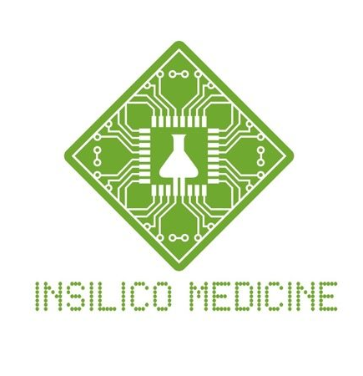
Evaluation of Market
Lowest Floor:
Insilico Medicines
One of the youngest in the group
Ratio of funding ($14.3 M) to estimated annual revenue ($5.5-6 M) might signal overvaluation
Utilizes AI platform in a singular way
Notes:
Parth

Slide 13
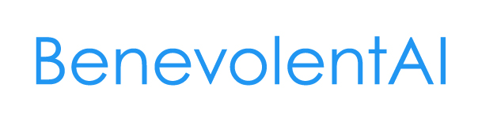
Evaluation of Market
Highest Ceiling:
BenevolentAI
Highest Estimated Annual Revenue
Funding is on par with that of other larger firms (late C stage)
Private Equity
Highest Valuation by significant amount
Notes:
Parth

Slide 14
Conclusion
These companies all leverage their AI platforms or partnerships in AI in various ways
Within the categories, there is a large variety of types of companies from smaller, younger firms to those that are more well-established
This results in a variety of types of revenue streams
The sector has experienced exponential growth in the past decade, from the introduction of new companies in the market to the discovery of new technologies
Notes:
Sabrina

Slide 15
Questions?
Notes:
Sabrina

